Slide 1
Apple Stock Forecasting
Team - 3
Mentor – Neha Gupta

Slide 2
Team Names
Mr. Mohammed Manal
Mr. Mohammed Irfan Navas
Ms. Amruta Ramchandra Bankar
Mr. Maddipatla Surendra
Mr. Arigela Kumar Gowri Sankar Sairam
Mr Chandan M
Ms. Swapna Elagandula
Mentor Name
Neha Gupta

Slide 3
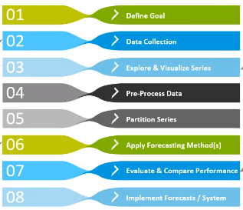
Objective : Predict the apple stock market price for next 30 days.
In the given data set, there are Open, High, Low and Close prices for each day starting from 2012 to 2019 for Apple stock.
Forecasting Model Building strategy

Slide 4
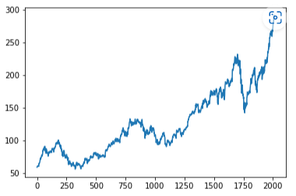
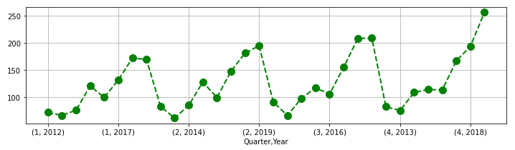
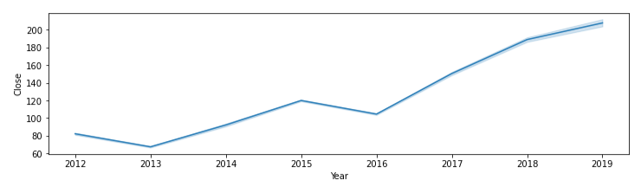
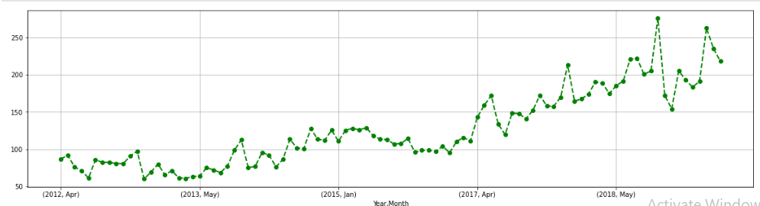
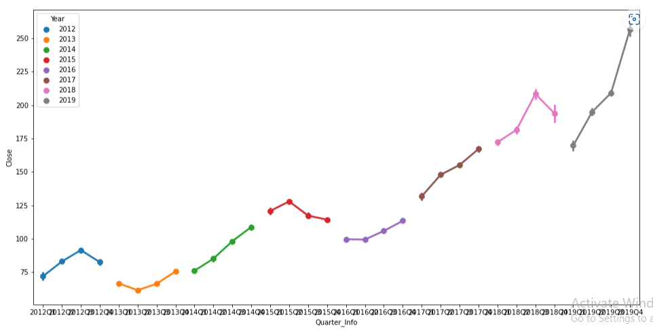
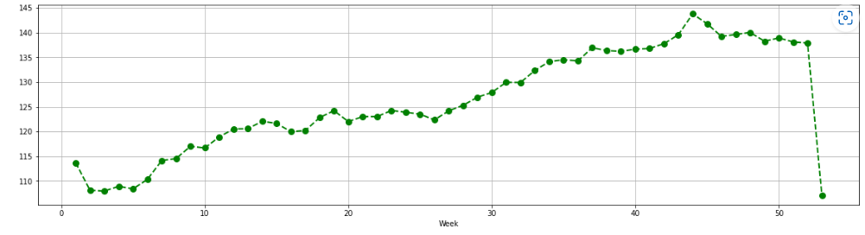
EDA
Line plot for Close
Quarterly wise plot for Close
Monthly wise plot for Close
Yearly plot for Close
Yearly wise plot
Weekly wise plot for Close

Slide 5
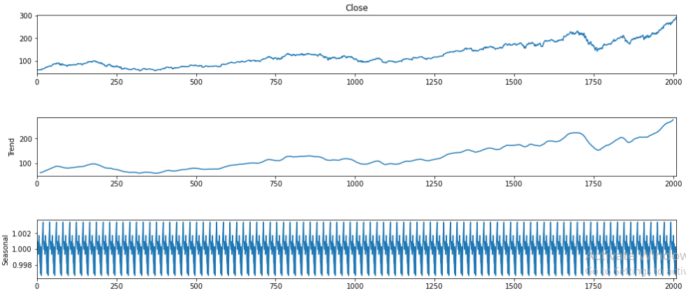
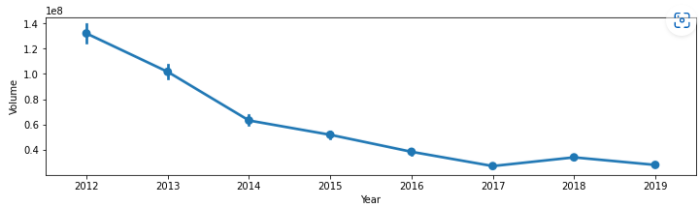
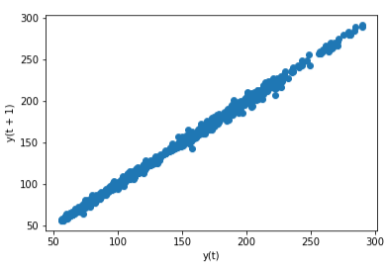
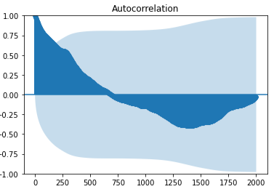
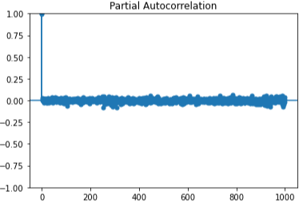
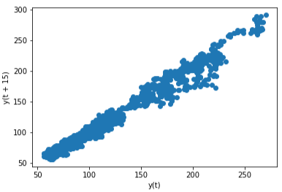
Volume plot
Time Series Decomposition plot
Lag plots
ACF & PACF plots

Slide 6
Modelling
Split The data set in to train & test
Build the model on train data set
Validate the model on test data set
Combine train & test and build the final model
Forecast using the final model
Model Deployment

Slide 7
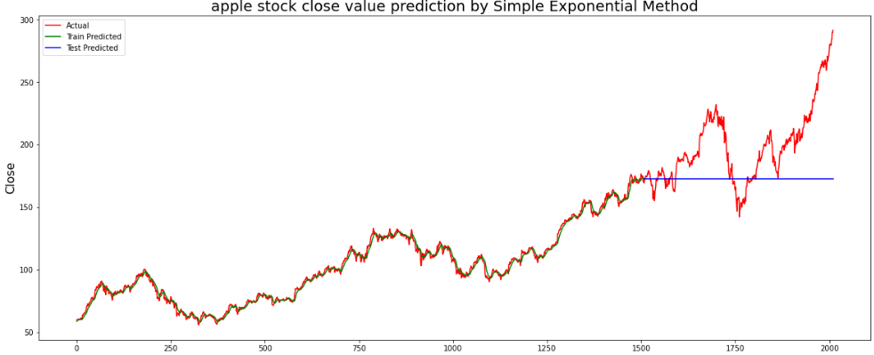
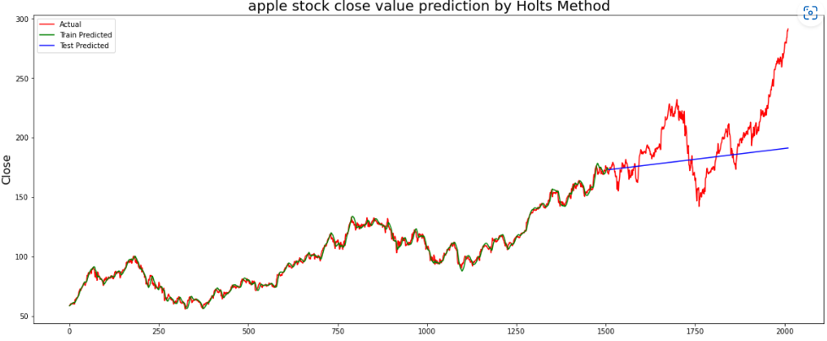
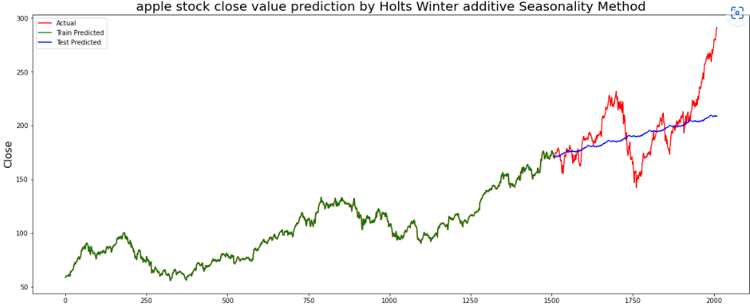
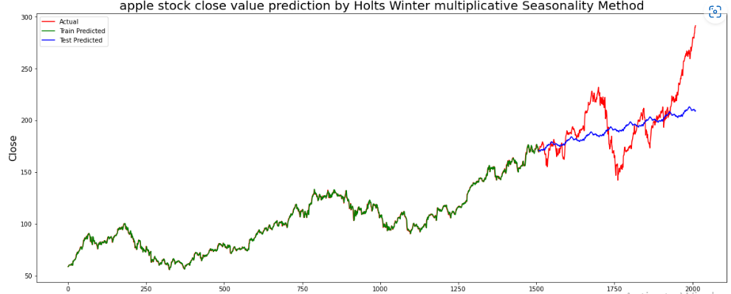
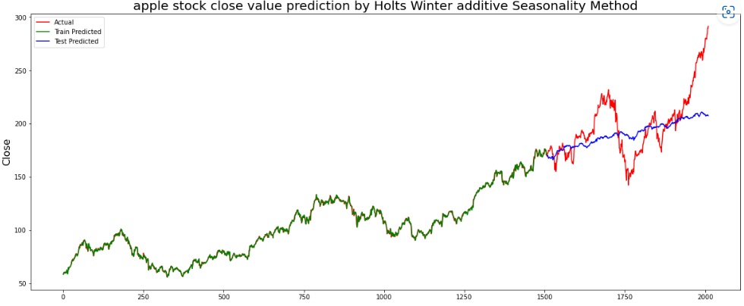
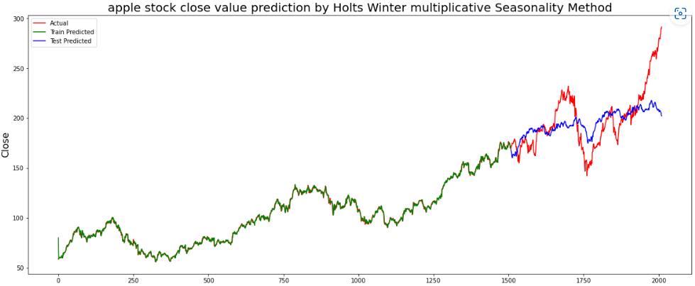
Data Driven Models

Slide 8
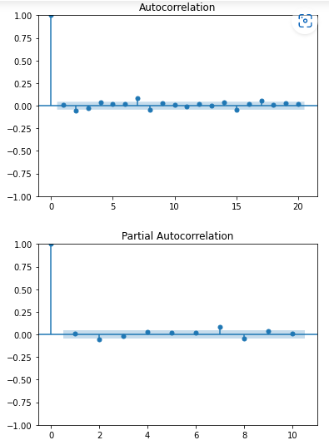
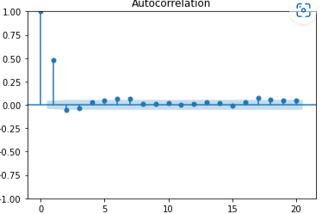
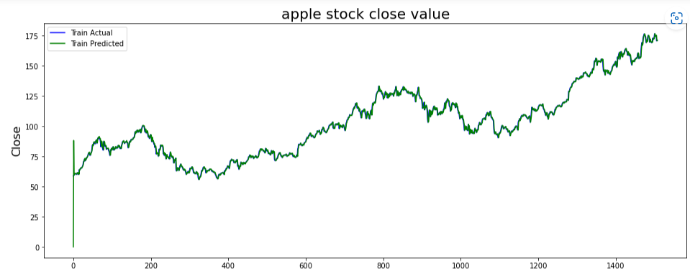
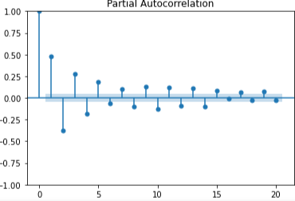
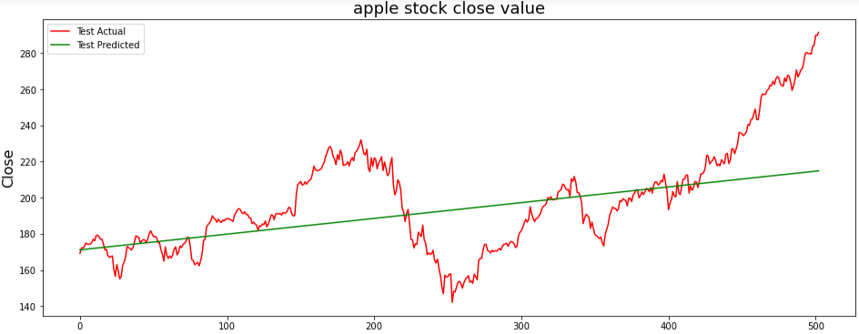
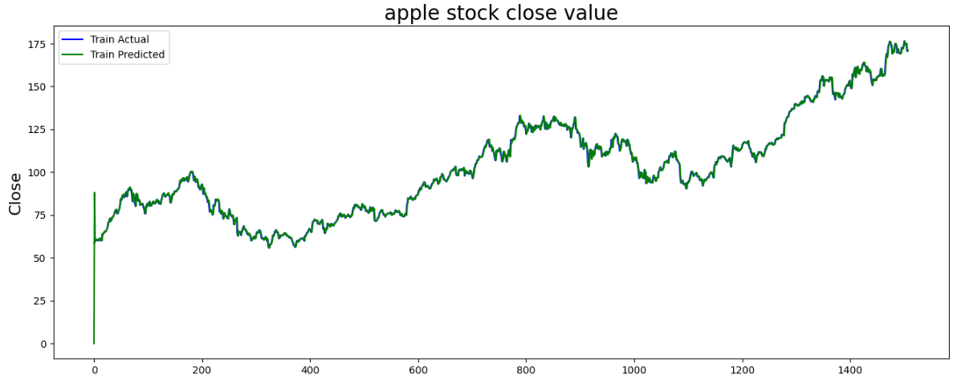
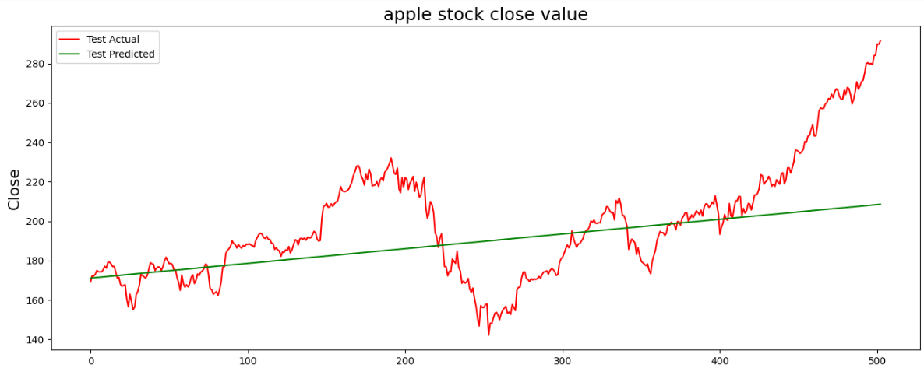
ARIMA Model
Arima order – 0,2,1
Arima order – 1,2,1

Slide 9
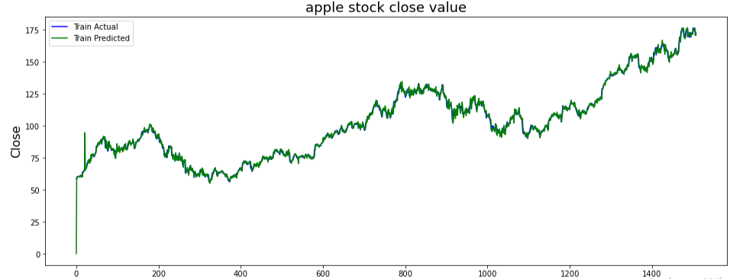
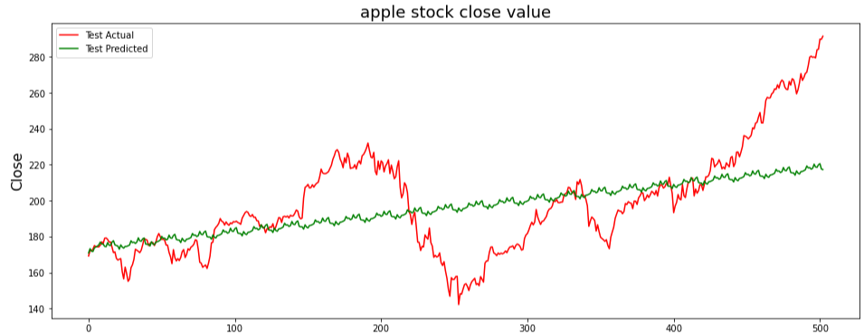
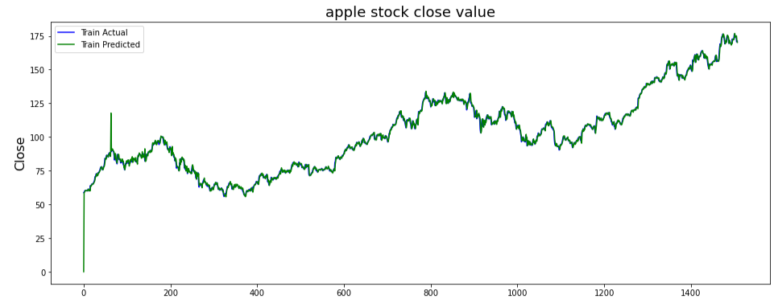
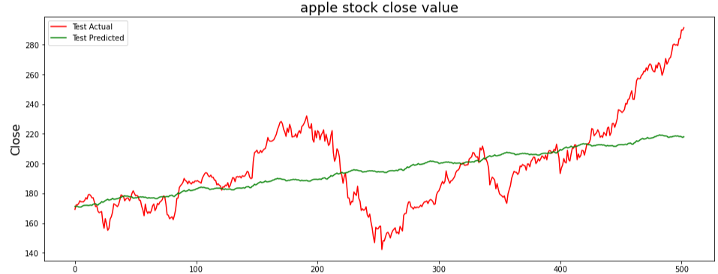
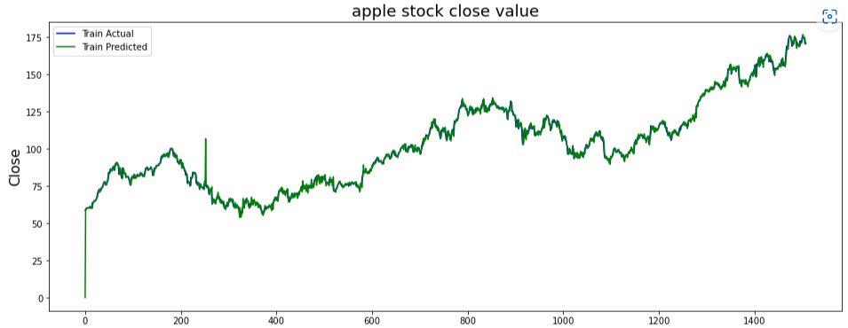
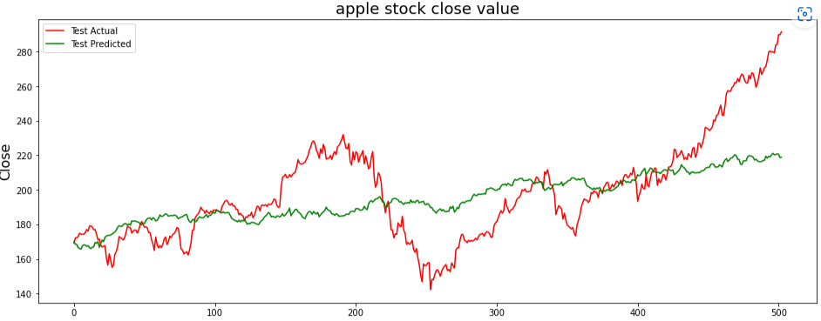
SARIMA Model
Sarima order-0,1,0 seasonal order-1,1,0,21
Sarima order-0,1,0 seasonal order-1,1,1,63
Sarima order-0,1,0 seasonal order-2,1,0,252

Slide 10
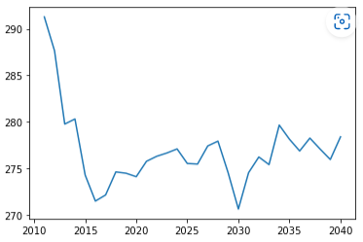
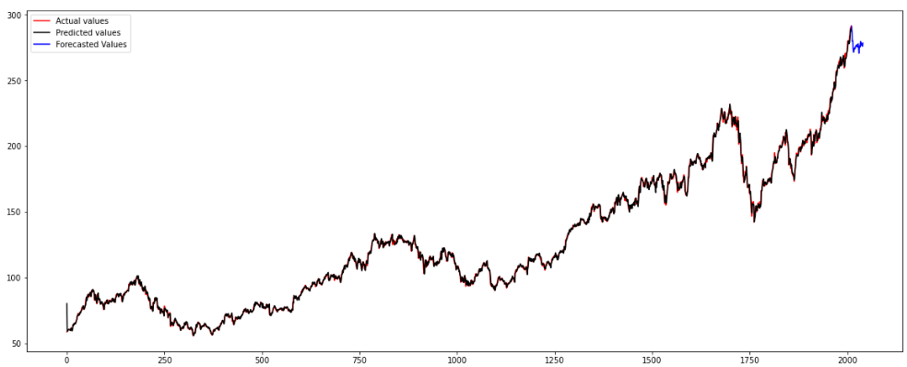
Model Evaluation Results
Method | Train RMSE | Test RMSE
Simple Exponential smoothing | 2.587 | 39.475
Holts Method | 2.512 | 31.287
Holts Winter with additive quarterly seasonality | 1.513 | 25.707
Holts Winter with additive annual seasonality | 1.418 | 24.86
Holts Winter with multiplicative quarterly seasonality | 1.505 | 25.378
Holts Winter with multiplicative annual seasonality | 1.512 | 23.776
Arima(order-0,2,1) | 2.288 | 24.534
Arima(order-1,2,1) | 2.288 | 25.875
Arima(order-1,2,1) | 2.288 | 25.846
SARIMAX(2, 1, 0)x(1, 1, 0, 21) | 2.557 | 24.036
SARIMAX(1, 1, 0)x(1, 1, 0, 21) | 2.558 | 24.006
SARIMAX(0, 1, 0)x(1, 1, [1], 63) | 2.339 | 23.901
SARIMAX(0, 1, 0)x(1, 1, 0, 252) | 2.548 | 25.613
SARIMAX(0, 1, 0)x(2, 1, 0, 252) | 2.503 | 23.507
Final Model

Slide 11
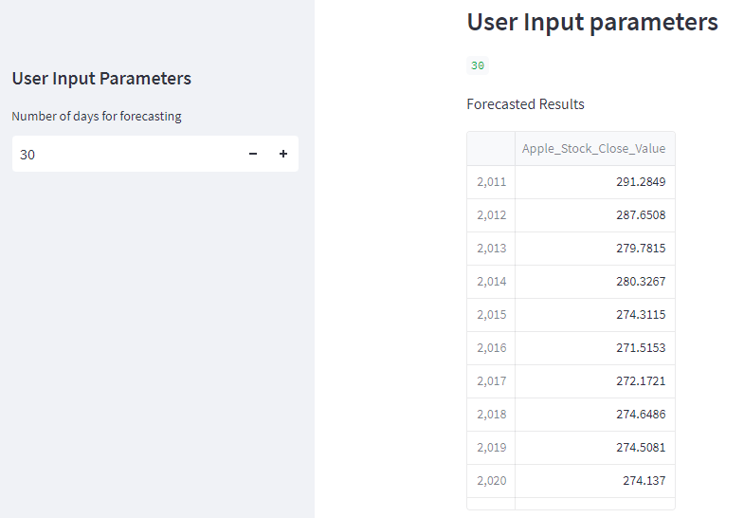
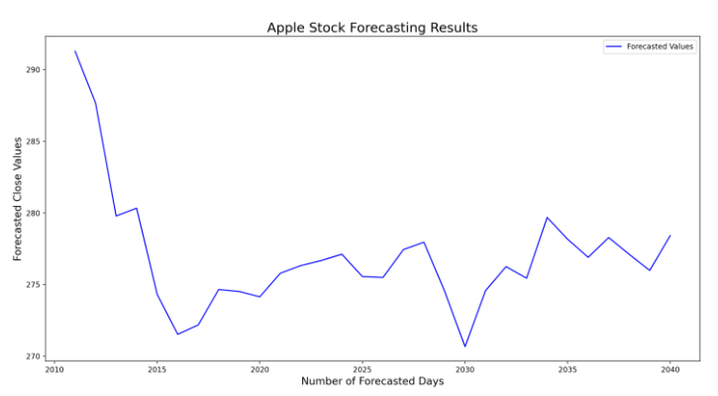
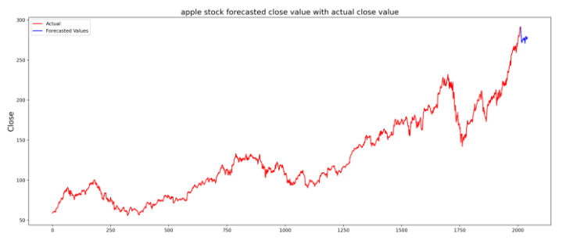
Deployment
Link:
https://sairamarigela-applestockforecasting-apple2-kcgawd.streamlit.app/

Slide 12
Thank You

